Slide 1
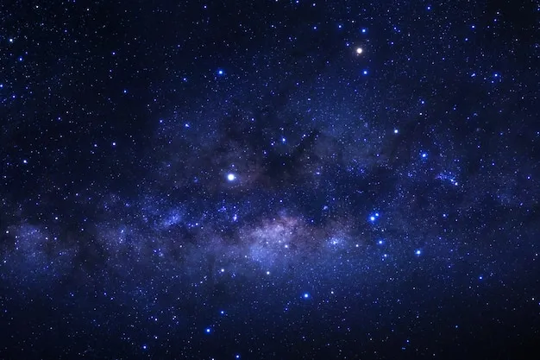
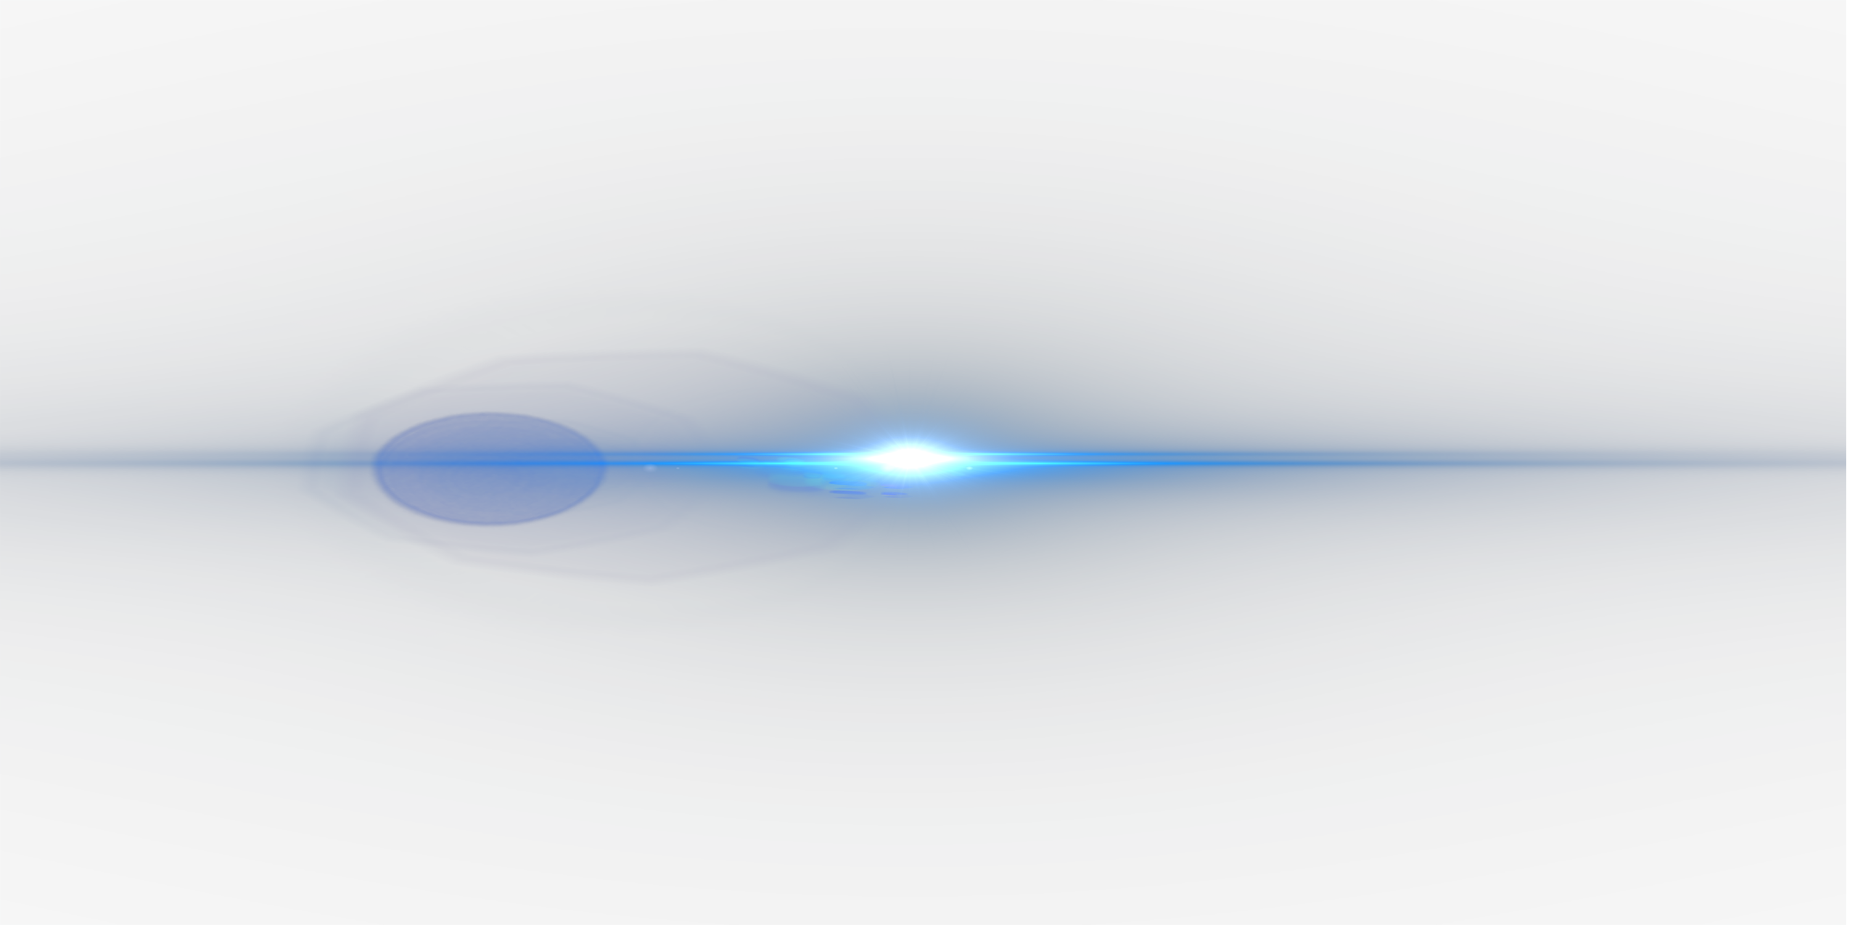
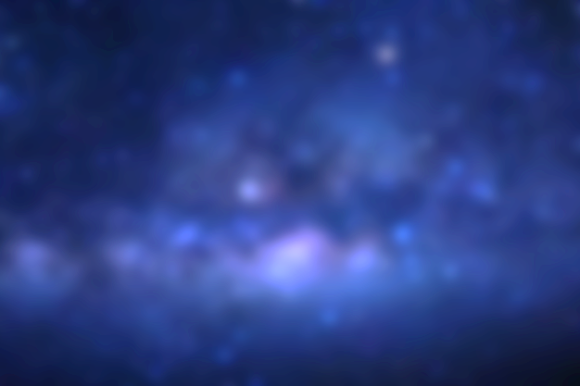
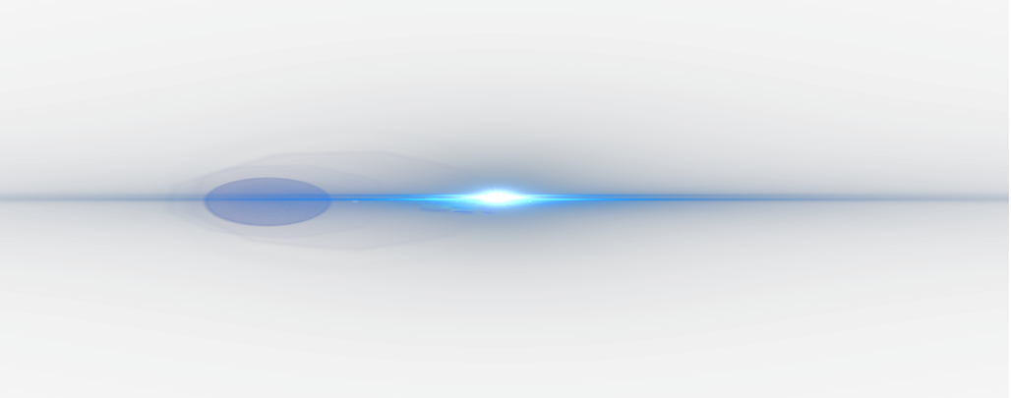
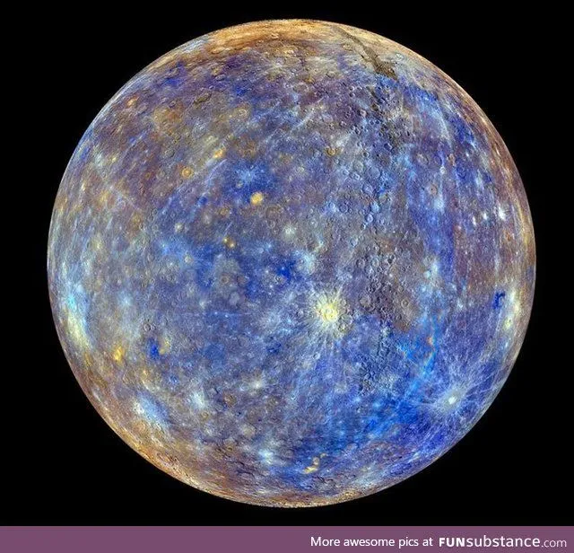
MERCURY
The smallest planet in our Solar system and nearest to the sun . Mercury is the hottest planet .
And is slightly larger than our moon
SIZE
3,o32 Miles

Slide 2
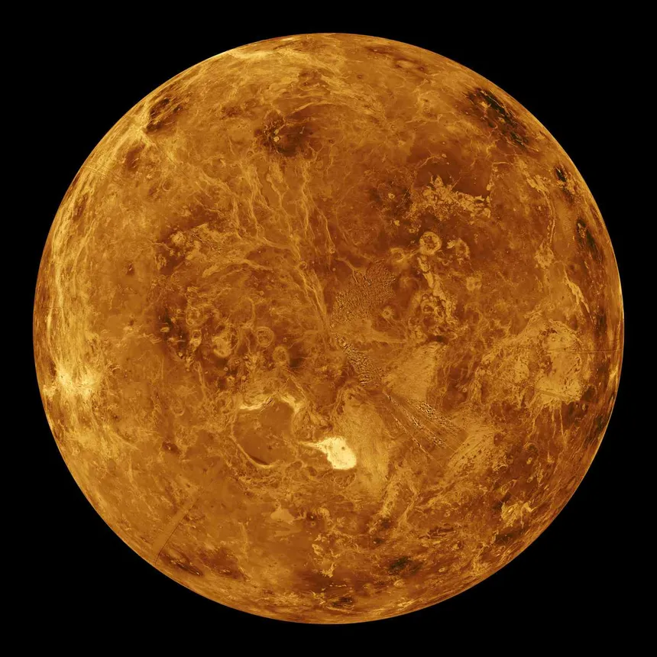
VENUS
This is second planet in our solar system, also know as evening star as it bright like a star in evening .
SIZE
4,092 Miles

Slide 3
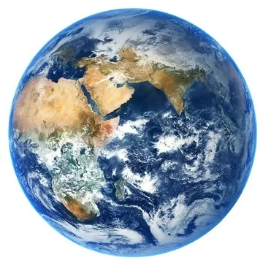
EARTH
Earth is the only planet in our solar system to support life and has water, air, trees and food for a living .
SIZE
5,942 Miles

Slide 4
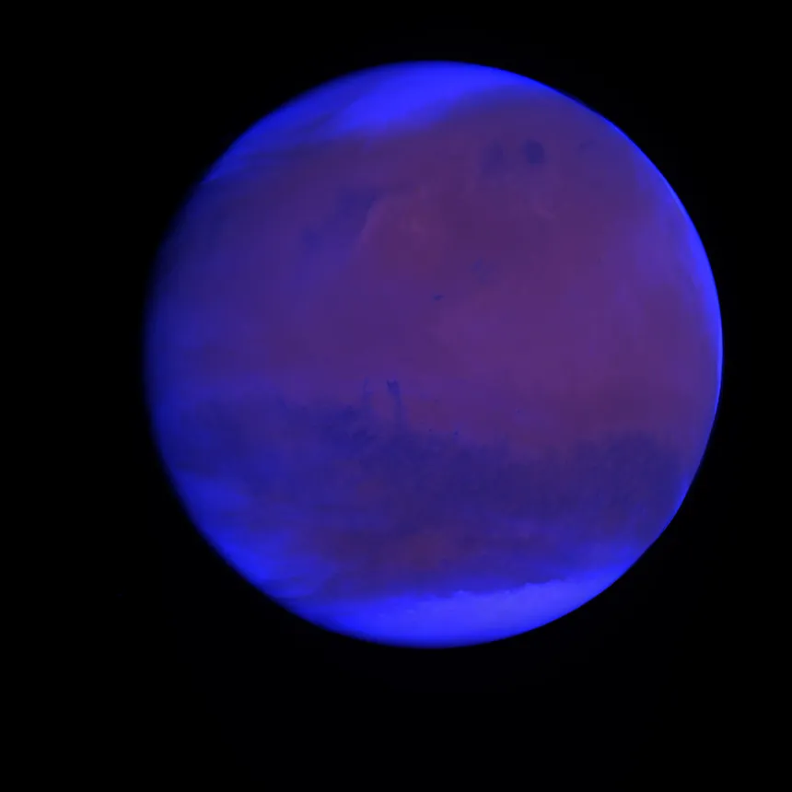
MARS
Mars is the fourth planet and currently under observations of humans and can support life is has a harsh environment and blueish look.
SIZE
4,o32 Miles

Slide 5
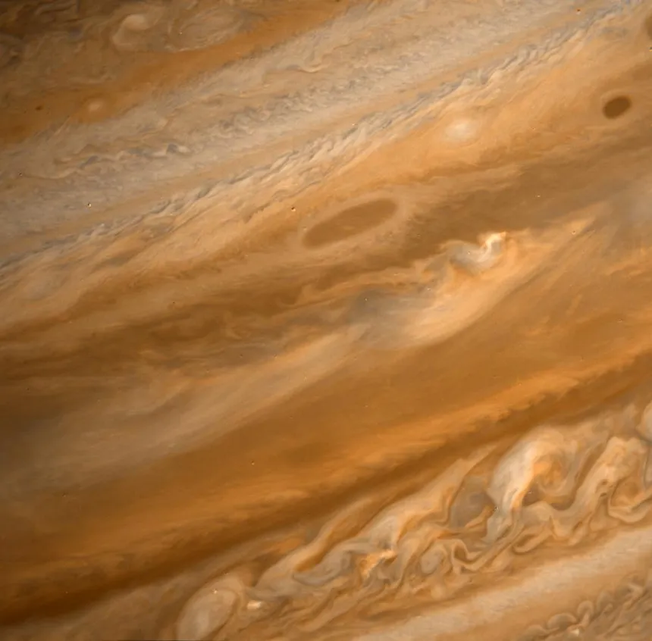
JUPITER
This is a gases giant planet and is the biggest planet in our solar system it is made up of gas and clouds and is biome is very harsh.
SIZE
7,234 Miles

Slide 6
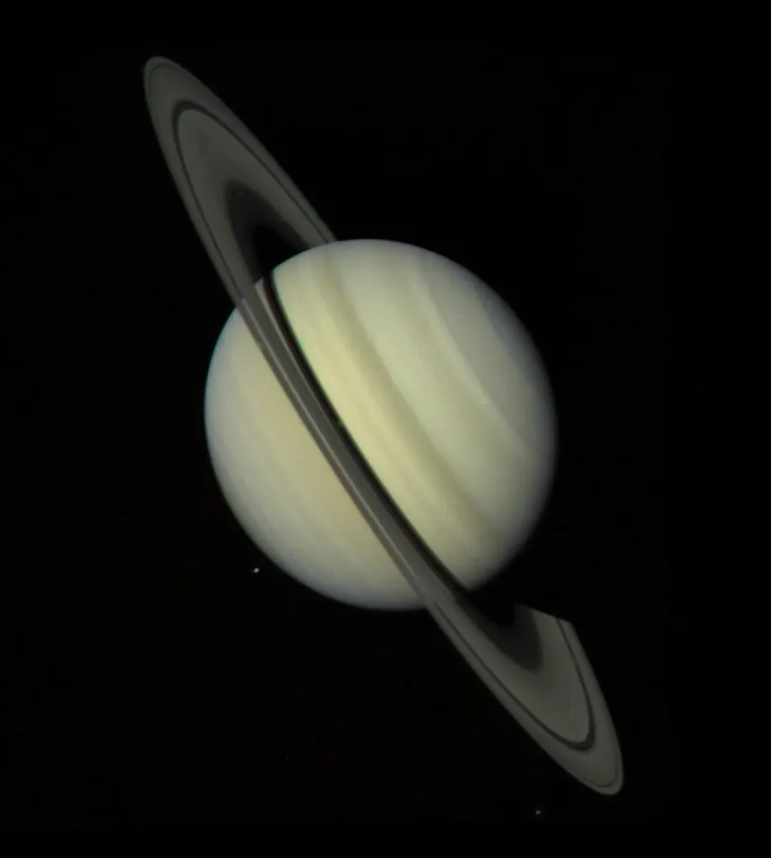
Satrun
Satrun is the most beautiful planet in our solar system and contains a wide ring surrounding it is the sixth planet in our solar system.
SIZE
6,o32 Miles

Slide 7
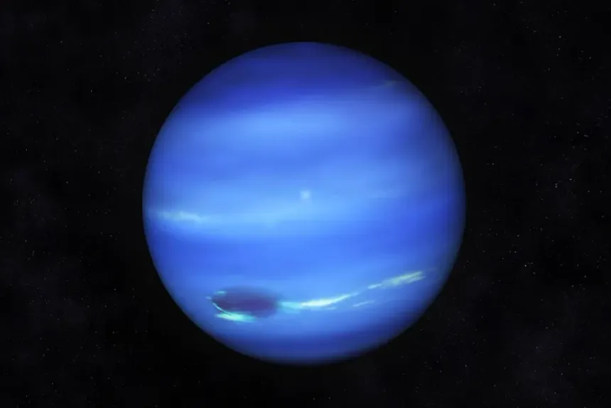
URANUS
Uranus is the seventh planet in our solar system and is a gases planet, not much is known about this planet as it very far away from our reach.
SIZE
4,o32 Miles

Slide 8
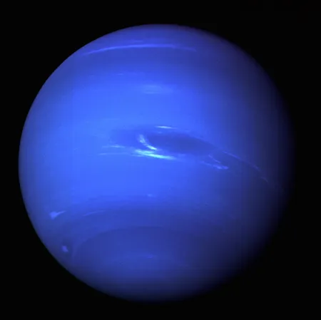
NEPTUNE
The last watery planet of our solar system is Neptune which is blue in color it is said that it is made up of water and has no land a watery planet.
SIZE
3,893 Miles

Slide 9
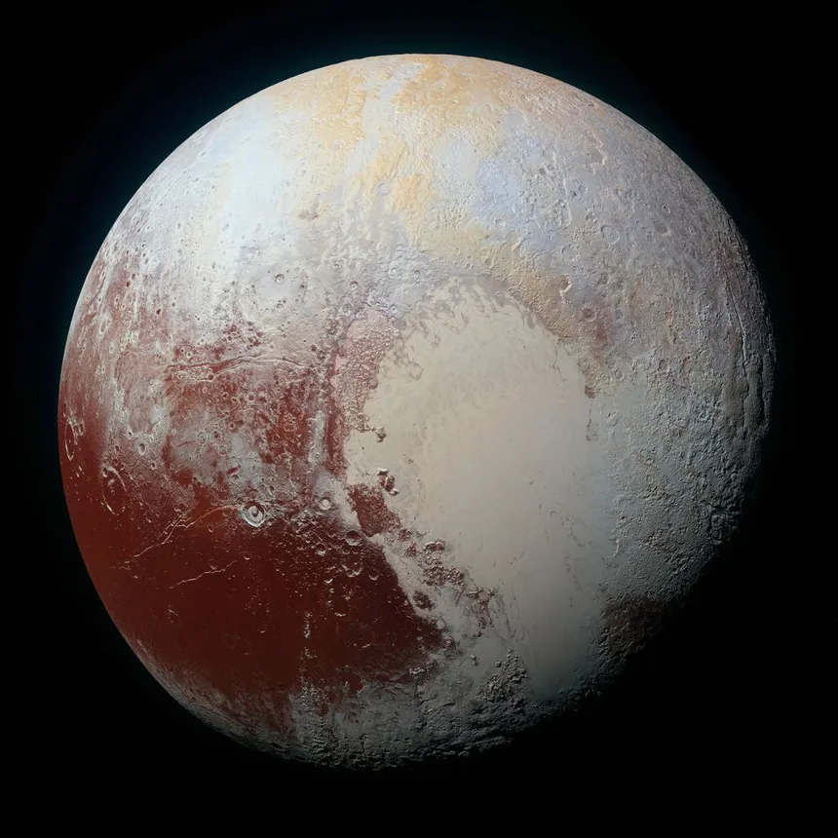
PLUTO
This is the unofficial planet and the smallest in the solar system and was not considered as a planet before and later added to the list .
SIZE
1,893 Miles

Slide 10
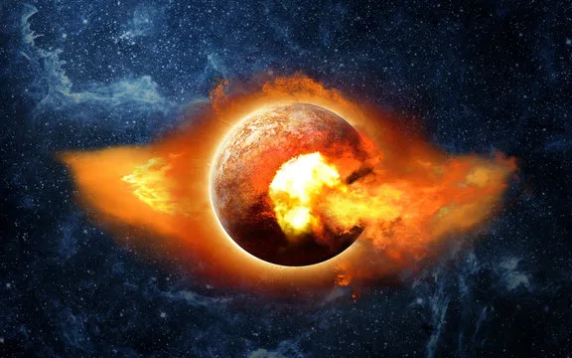
PLANET X
Planet X is a hypothetical planet believed to there by many but is so far away from the solar system and has a long period of cycle.
SIZE
8 ,893 Miles

